Slide 1
Nigiwai detection

Slide 2
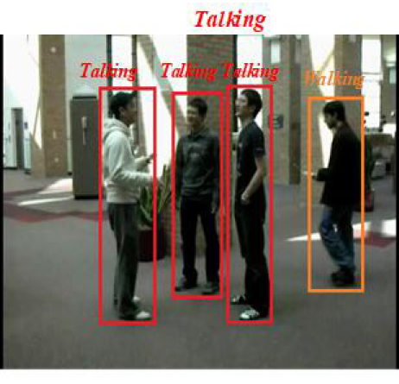
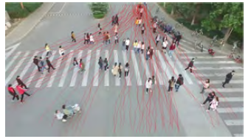
The important question is: How to deal with the problem of Nigiwai?
I found that Nigiwai detection is nearest to these research points:
1- group activity recognition
Target is to classify an action of group.
However, most of these works are related to few people and close camera
2- pedestrian trajectory clustering
The target is to cluster pedestrians into groups according to their trajectories motion.
First, the pedestrians are detected, then their trajectories are obtained.

Slide 3
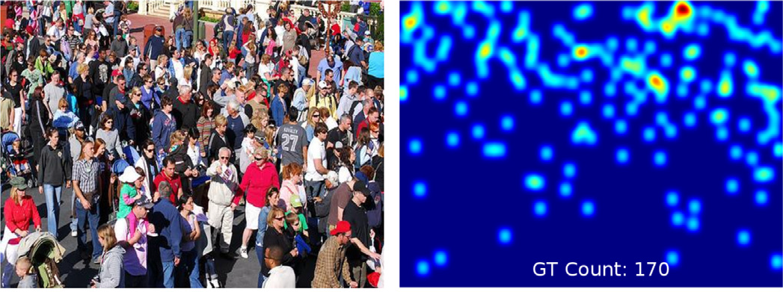
Continue.
3- tracklet clustering (motion features)
Different from (2), that pedestrian are not detected, but sparse points are extracted and tracked (tracklet) then are clustered
4- Crowd density estimation
Most of them working on still images, by counting or estimate the number of crowd people
density map with count

Slide 4
The question is:
Is there is one track from previous mentioned tracks I should work with it?

Slide 5
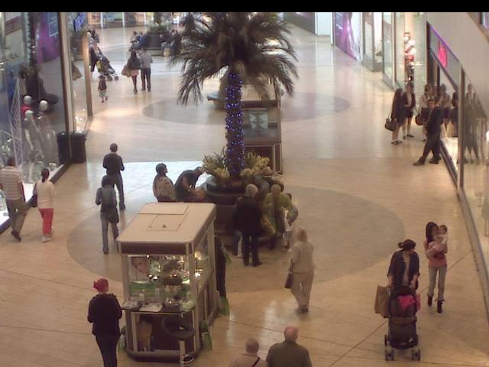
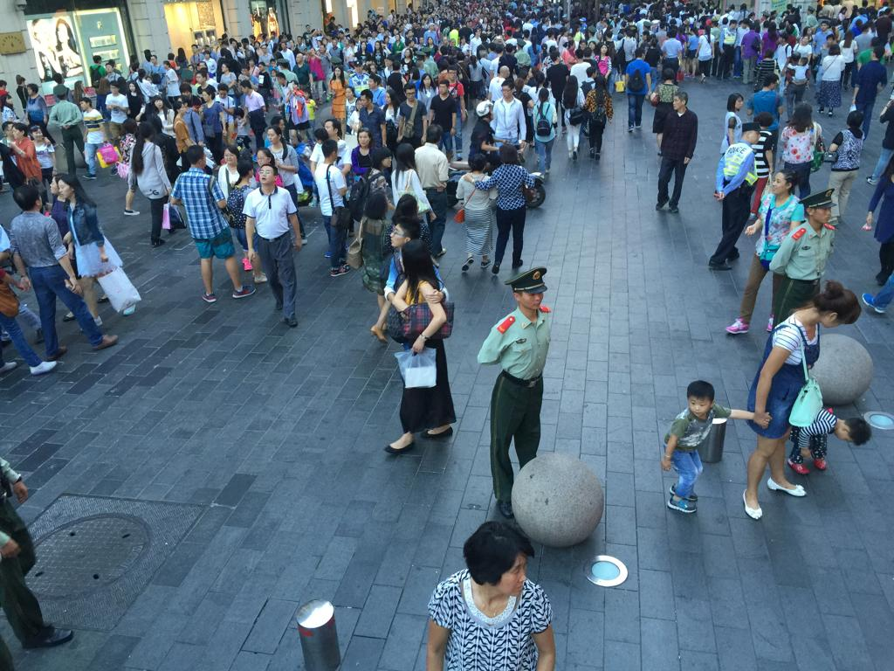
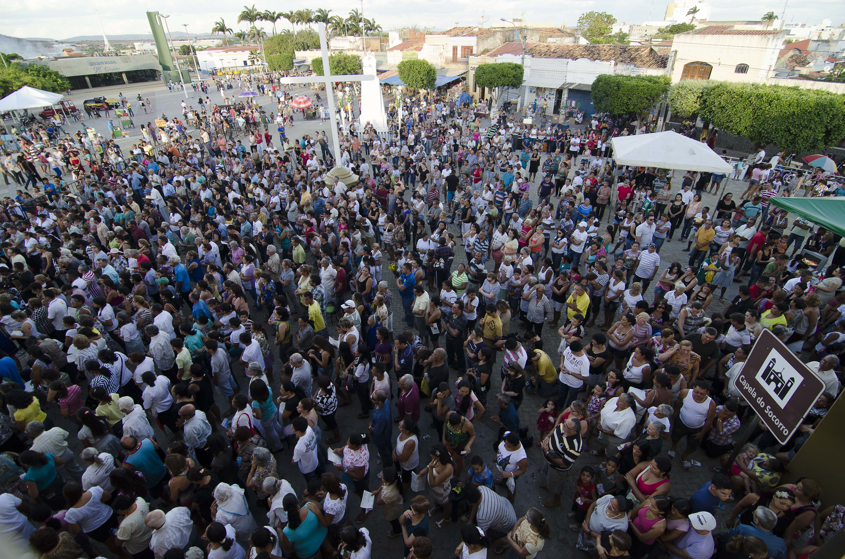
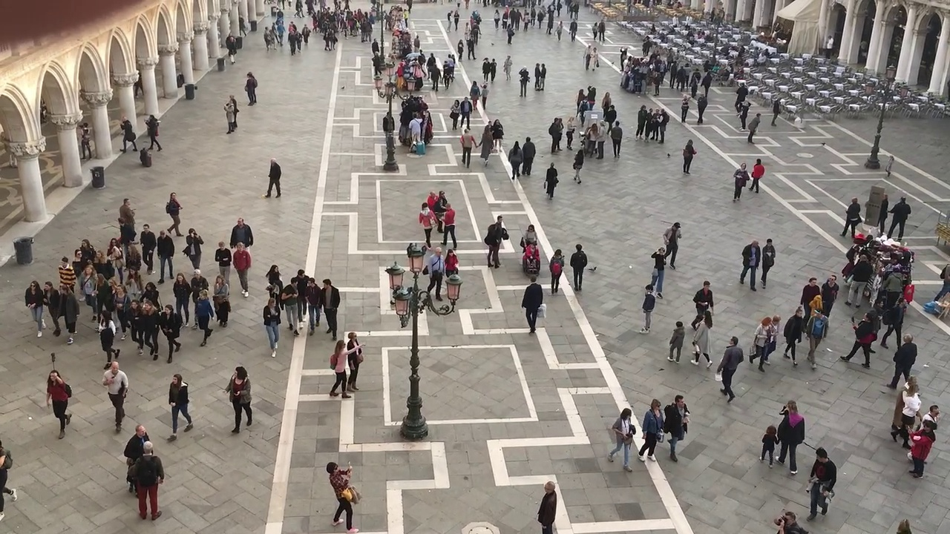
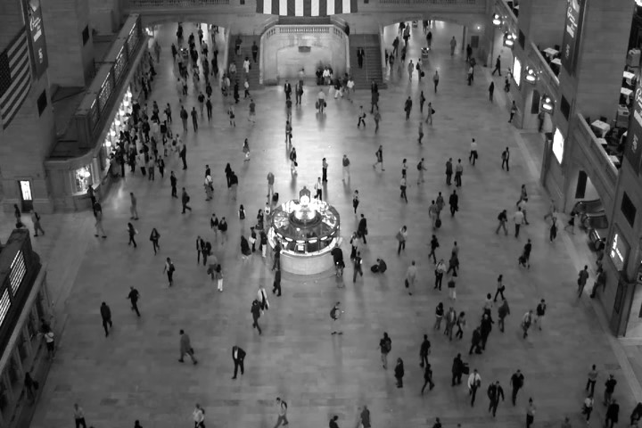
Crowd datasets
Most of these datasets consist of still images or a low frame rate video
Mall dataset
ShanghaiTech A, B
UCF-QNRF_ECCV18
Venice Dataset
Train Station

Slide 6
Summary for my done work
Try to find a score for Nigiwai events (using the pedestrian trajectories) in two ways:
1- by giving a dynamic score for each pedestrian.
2- by giving a dynamic score for each pixel or region of pixels

Slide 7
Create a score for each pedestrian
Let try to measure Nigiwai by:
N_{nigh} is taken only by Euclidean distance
v_{i} is reprented by (std(x_{i})+std(y_{i}))
W_{N}=1, W_{v}=10
Video-Nigiwai-score-eachPerson (shown before)
Video-heatmap (new)

Slide 8
Giving a dynamic score for each region
The idea is:
For each region in a frame, scores of all people moving in this region are summed every frame.
This value is accumulated through frames i.e, it continue increases as long as people (having a score >0) are moving through it.
This accumulated value is divided by a function of time, so it is decayed as long as no people come.
Click to watch the video (shown before)

Slide 9
Determine number of pedestrian in each region
Simply, only compute the number of pedestrian in each block.
This give an indication of the instantaneous density.
Also, by accumulate this number and divide by the frame NO (time), this gives average number with time.
Click to watch the video (new)
Click to watch the video (new)

Slide 10
I want to know your opinion
Is there is one track, from the mentioned tracks, I should work with it?
1- group activity recognition
2- pedestrian trajectory clustering
3- tracklet clustering (motion features)
4- Crowd density estimation
Or may be combined between more than one

Slide 11

THANK YOU

